Slide 1
SUPERVISED ML REGRESSION CAPSTONE PROJECT Prediction of demand for shared bikes

Slide 2
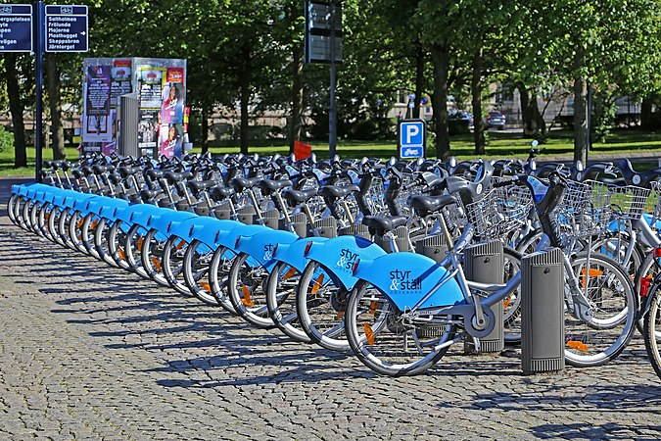
Contents
Introduction
Problem Statement
Points for discussion
Data Summary
Analyzing Exploratory Data
Overview of Modeling
Important Feature
Conclusion

Slide 3
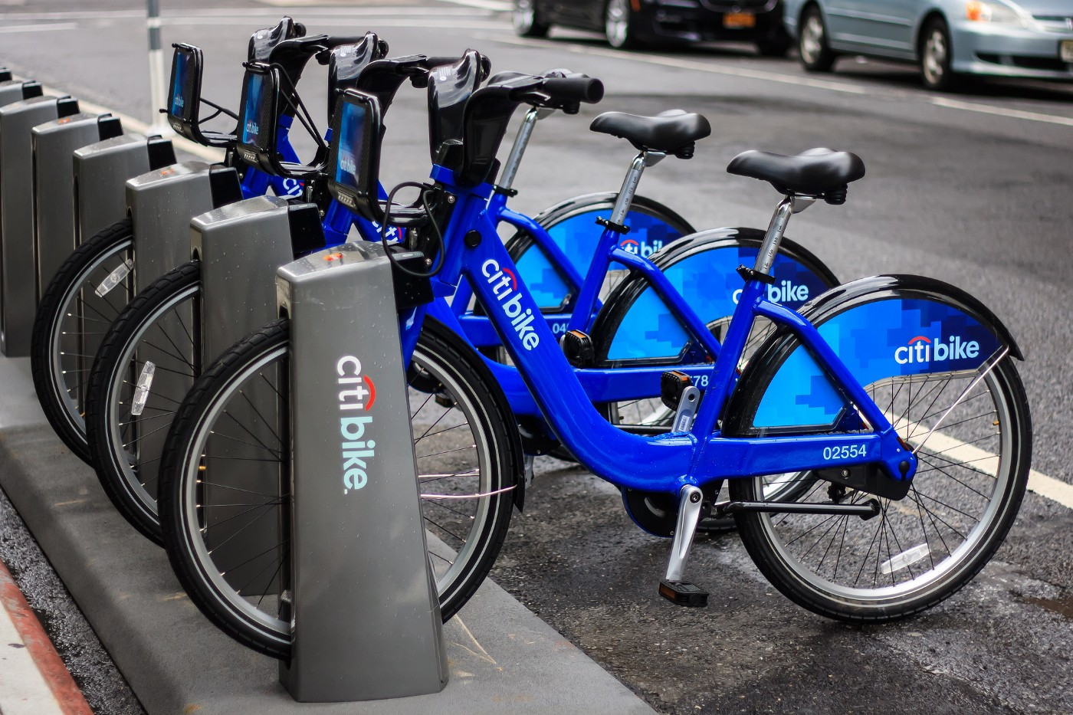
Introduction
Motorcycles are rented out by a bike rental or bike hiring company for brief periods of time, typically a few hours. Most bike shops offer rentals as a sideline to their primary businesses of sales and service; however, some stores specialize in this service.
Like car rental businesses, bicycle rental businesses generally cater to those without access to vehicles, usually travelers and especially tourists.
For people who want to do a multi-day bike tour of a specific location but don't want to ship their own bikes, bike rental shops that rent by the day or week as well as by the hour are a great option.
For people who want to do a multi-d.

Slide 4

Problem Statement
Rental bikes are currently being introduced in many big locations to improve mobility comfort.
It is crucial to make the rental bikes accessible and available to the general public at the appropriate time since it reduces waiting.
Eventually, maintaining a steady supply of rental bikes for the city emerges as a top priority.
Predicting the number of bikes needed to maintain a steady supply of rental bikes at each hour's interval is essential.

Slide 5
Points for discussion
Booking bikes throughout the year, on working days, weekends, and holidays.
Comparing the number of rented bikes with the numerical data columns.
Examining the linear relationship between the numerical data columns and the count of rented bikes.
Climate Impact on Bike Sharing During Different Seasons.
Correlation Map OR Heat Map
Grid Search CV for Hyperparameter Tuning, Linear Regression Analysis, Lasso Regression Analysis
XG boost, Random Forest Analysis, and Decision Tree Analysis
Importance of the Feature

Slide 6
Data Summary
Imported Libraries
In this part, we imported the required libraries NumPy, Pandas, matplotlib, and seaborn, to perform Exploratory Data Analysis and for prediction, we imported the Scikit learn library.
Descriptive Statistics
In this part, we start by looking at descriptive statistic parameters for the dataset. We will use describe() this told mean, median, standard deviation
Missing Value Imputation
We will now check for missing values in our dataset. after checking not existed any missing values, In case there are any missing entries, we will impute them with appropriate values.
Graphical Representation
We will start with Univariate Analysis, bivariate Analysis and conclude with various prediction models driving the Demand for bikes.

Slide 7
Analyzing Exploratory Data
Date: Date in year-month-day format
Rented Bike Count: Count of bikes rented at each hour
Hour: Hour of the Day
Temperature: Temperature in Celsius
Humidity: Humidity in %
Windspeed: Speed of wind in m/s
Visibility (10m): Visibility
Dew point temperature: Dew Point Temp (Celsius)
Solar radiation: Radiation in MJ/m2
Rainfall: Rainfall (mm)
Snowfall: Snowfall (cm)
Seasons: Winter, Spring, Summer, Autumn
Holiday: Holiday/No holiday
Functioning Day: if the day is neither weekend, holiday than 1 else 0

Slide 8
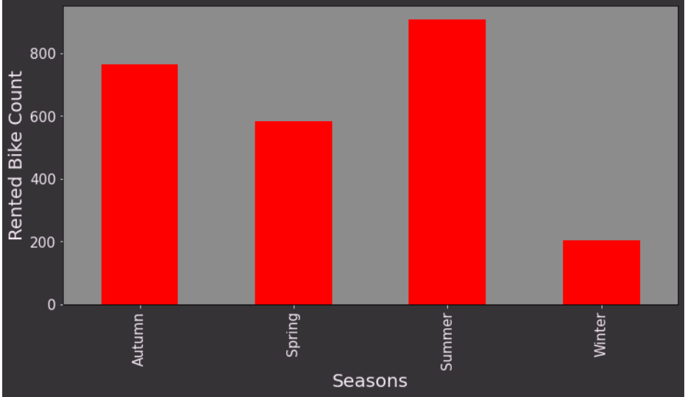
Bikes Rented per Season
The summer season saw the most bike rentals. 2.28 million bicycles were rented in total over the summer.
The second-highest number of bikes were rented in the autumn, at roughly 1.79 million, and were then rented in the spring, at 1.6 million.
The least frequent season to rent bikes seems to be winter. Only 487K bikes were hired during the winter.
The severe winter weather in Seoul may contribute to the low winter demand for bicycles.

Slide 9
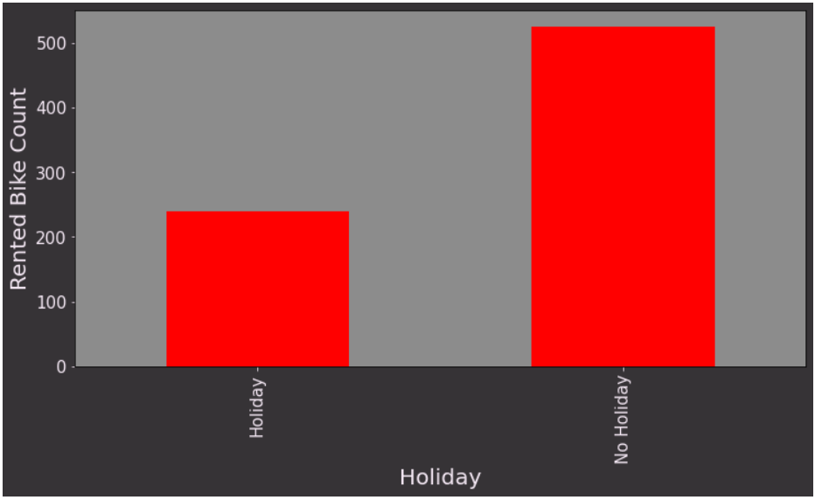
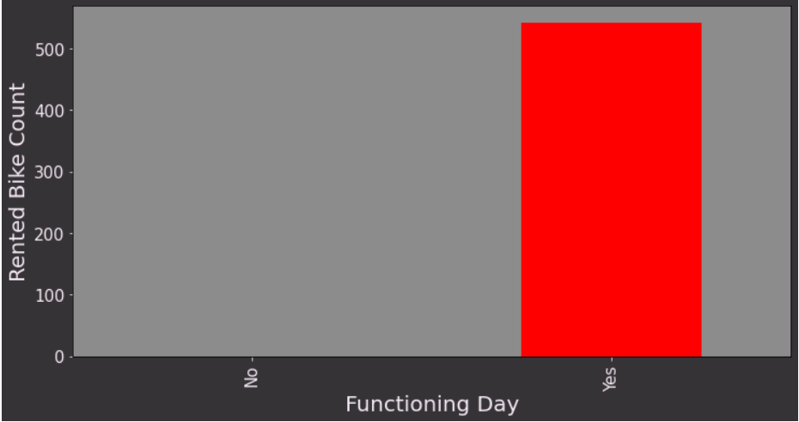
Bike Renting trend on holidays, Functioning days
Compared to holidays, non-holiday days are when people prefer to ride their bikes.
Only 215K bikes were rented during holidays, while 5.9 million bikes were rented on non-holiday days.
It is safe to assume that the working class of Seoul makes up the bulk of the customers in the bike rental industry.
Every bike that was hired was out on a working day.

Slide 10
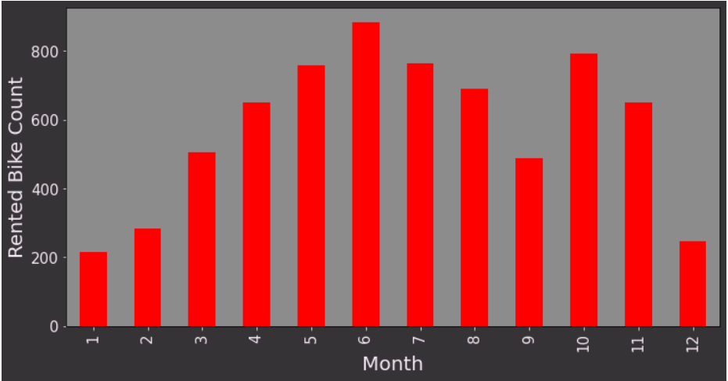
Bike Booking Monthly Trend
June is the most preferred month for bike booking around 896K bikes were rented in June.
July and May are the second and third best.734K bikes were booked in July, and 707K were booked in May.
Demand for bikes was least in Jan, followed by Feb and Dec. 150K bikes were rented in Jan, 151k in Feb, and 185K in Dec.

Slide 11
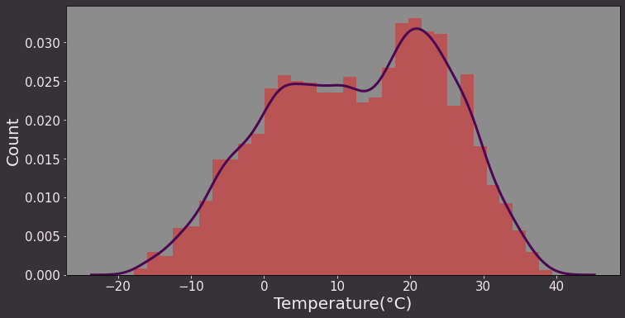
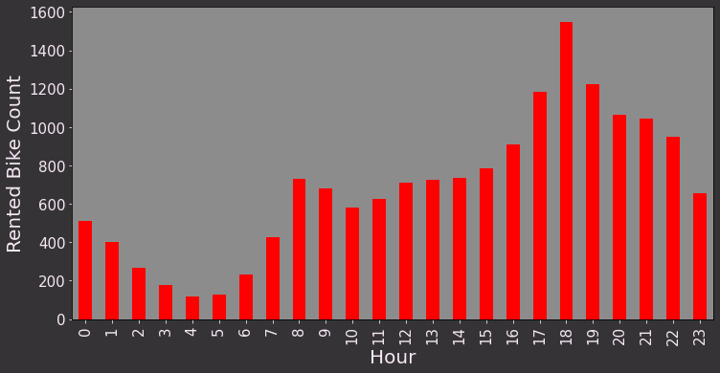
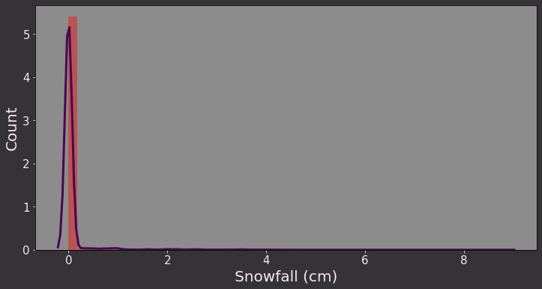
Rented Bike Count Against Numerical Data
Most preferred bike-sharing temperature is 20- 30 degrees Celsius. Bike renting is minimal when the temperature is >35 or <5 degrees Celsius.
Bike sharing is at its peak between 4 pm to 8 pm. Bike-sharing is at least between 2 am to 6 am, it increases from 6 am onwards until 8 am.
Snowfall is least favorable for the bike renting Business.

Slide 12
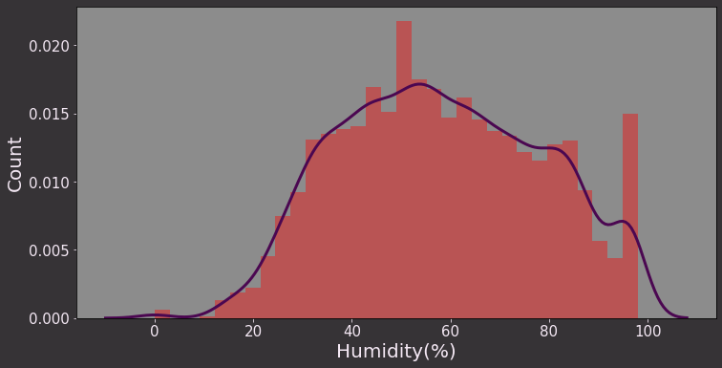
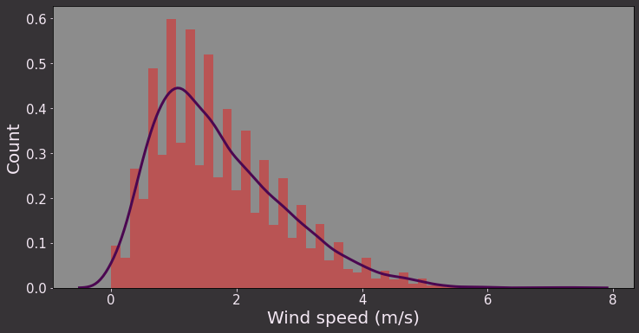
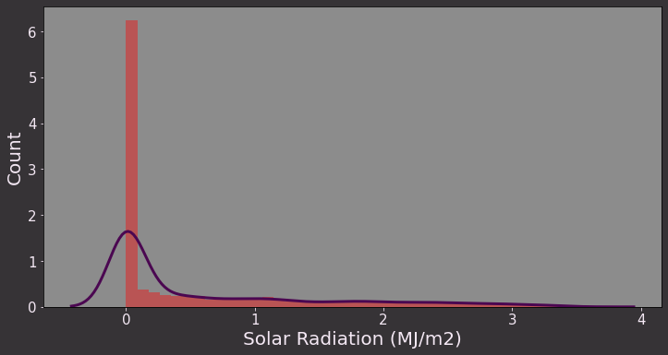
Rented Bike Count Against Numerical Data
Bike renting is at its peak when the humidity is 40%- 60%. People avoid bikes when the climate is too humid or too dry.
Favorable wind speed for Bike sharing is 1m/s -2 m/s as wind speed goes beyond 2m/s the count of bike-sharing starts dropping reaching minimal when the speed > 5m/s.
Bike sharing is at its peak when the radiation is minimal.

Slide 13
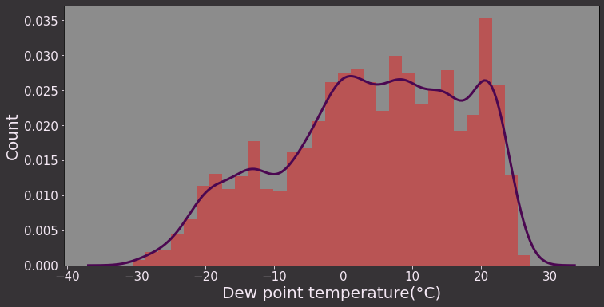
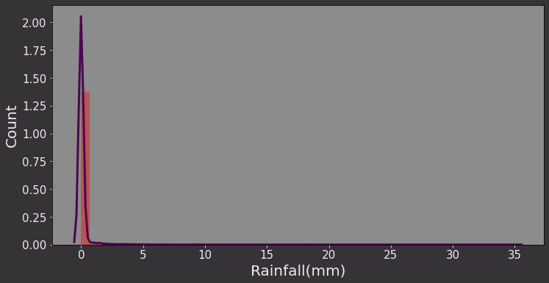
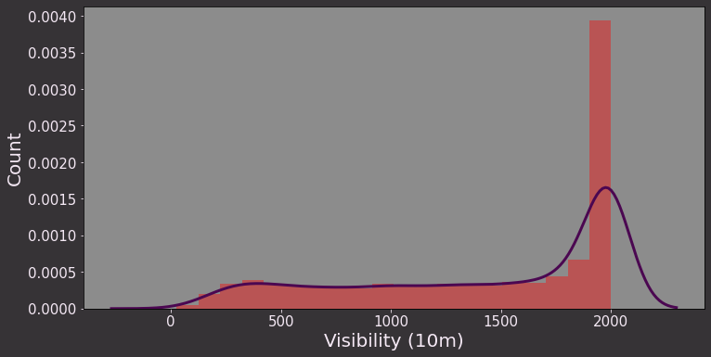
Rented Bike Count Against Numerical Data
Dew point temperature between 5-25 Degrees is most favorable for Bike sharing.
Demand for bikes dwindles in case of rainfall.
Visibility is an important factor for bike riders, bike sharing is at its peak when the visibility is maximum

Slide 14
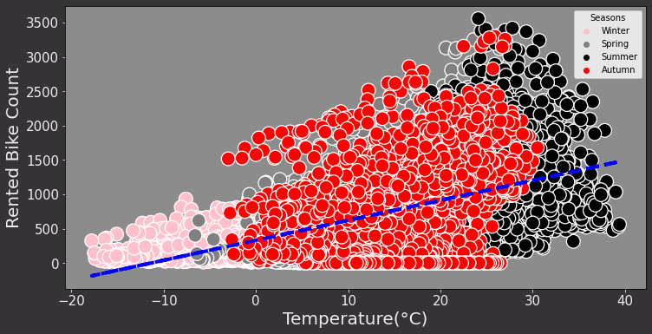
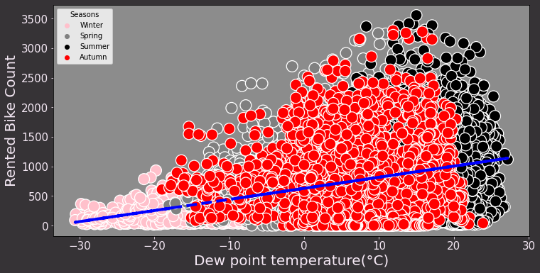
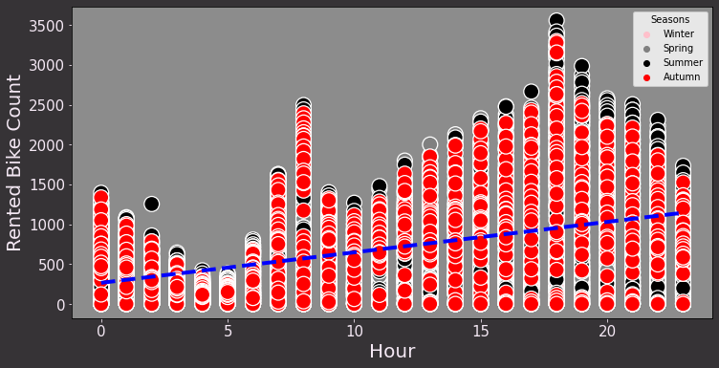
Co-relation: Rented bike count vs Temp, Dew point Temp, Hour
Bike sharing is positively co-related to temperature and Dew point Temperature as the temperature approaches 30 degrees.
Though one thing to notice the positive co-relation is applicable only because the temperature in Seoul rarely crosses 40 Degrees.
Bike sharing count is positively co-related to hours as the Hours Progress from 0 (12 am) to 20 (8 pm) the bike-sharing count increases.

Slide 15
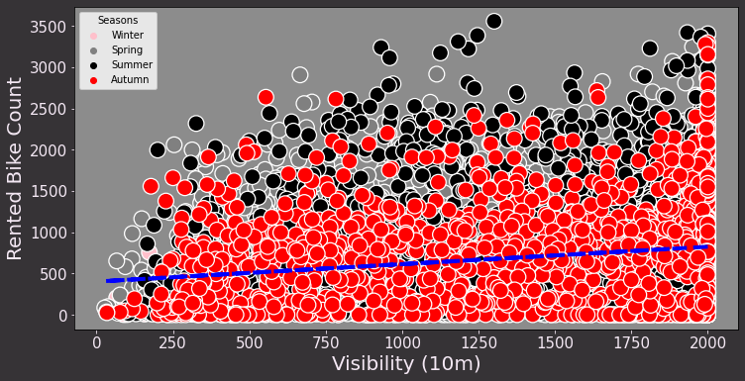
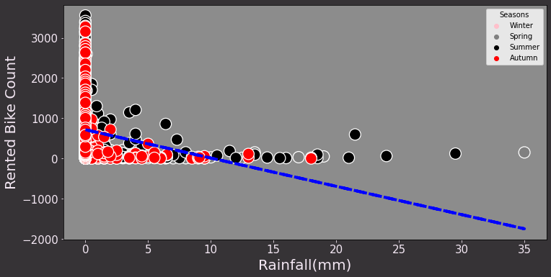
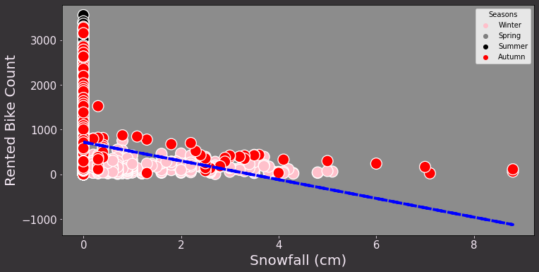
Co-relation: Rented bike count vs Visibility, Rainfall, Snowfall
Additionally, bike reservations and visibility have a minor positive correlation.
Snowfall and rain are negatively correlated with the number of bikes leased.

Slide 16
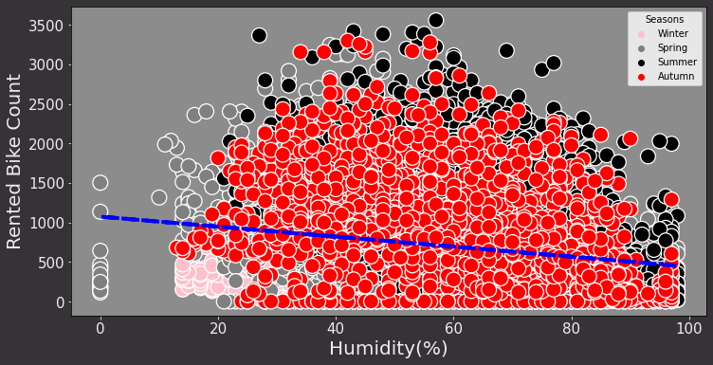
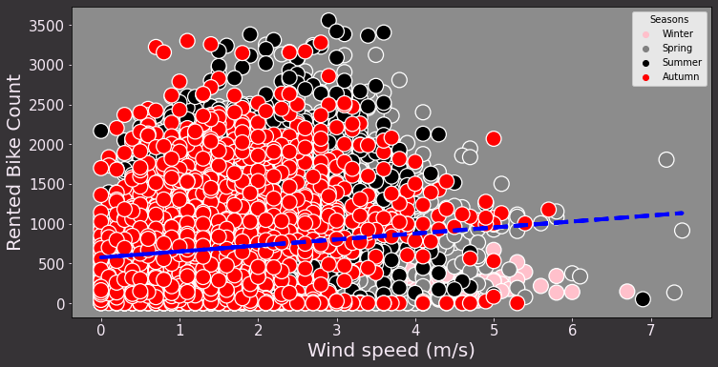
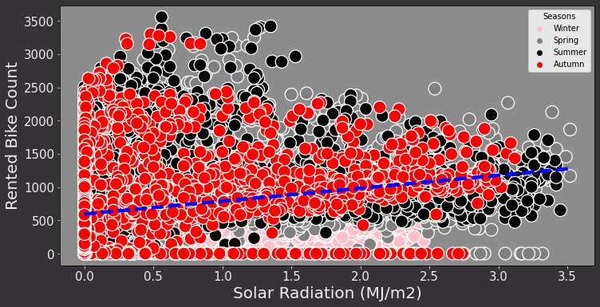
Co-relation: Rented bike count vs Humidity, Wind Speed, Radiation
A minor inverse relationship exists between the number of shared bikes and humidity.
Bike-sharing count and wind speed have a somewhat favourable relationship.

Slide 17
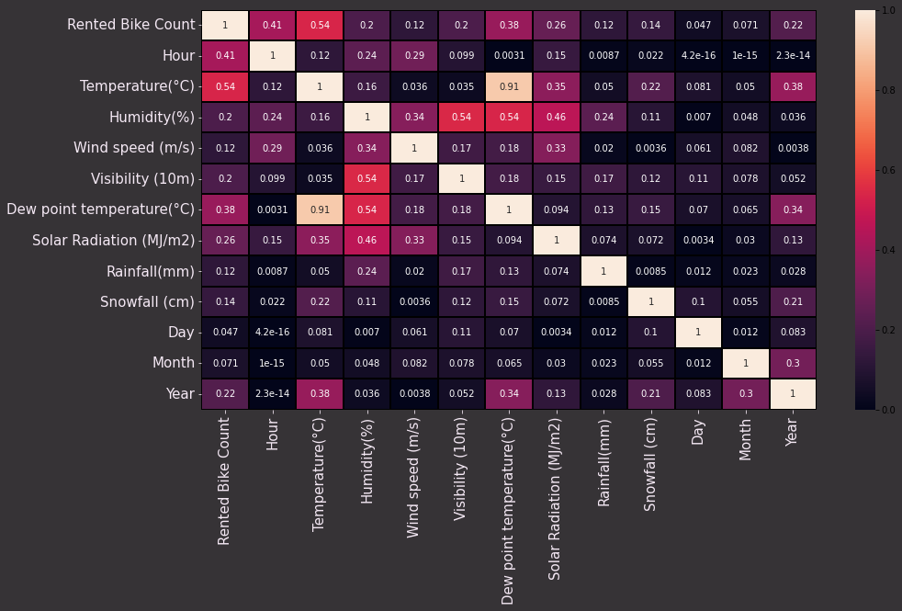
Correlation map
The relationship between the number of rented bikes and the heat map's indicators of hour, temperature, dew point, and solar radiation is somewhat positive.
Humidity, snowfall, and rain are all inversely correlated with the number of shared bicycles.
Dew point temperature and temperature have a positive correlation.

Slide 18
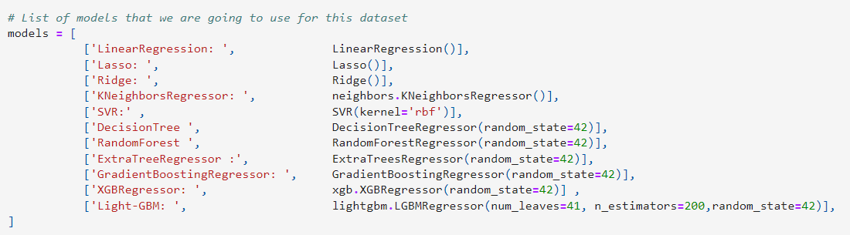
Models List
In order to compare the final Root Mean Square Error and R2 score of these models, a total of twelve models were used in this project.

Slide 19
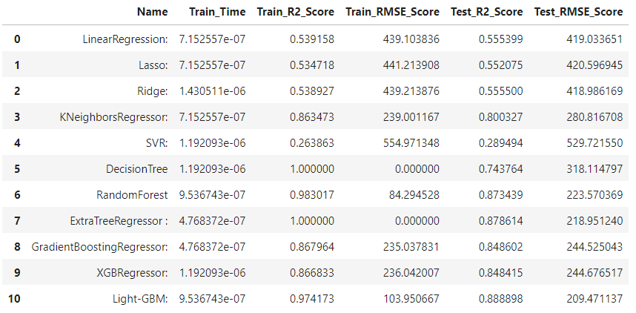
Result
Out of the twelve models, Lightgbm, ExtraTreeRegressor, and RandomForestRegressor provide the highest R2 score and the lowest root mean square error on the test set, as is evident.

Slide 20
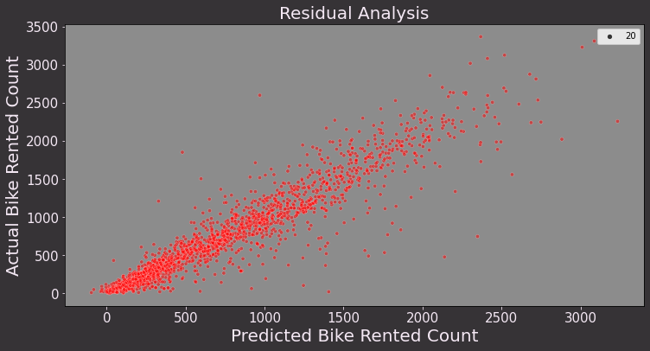
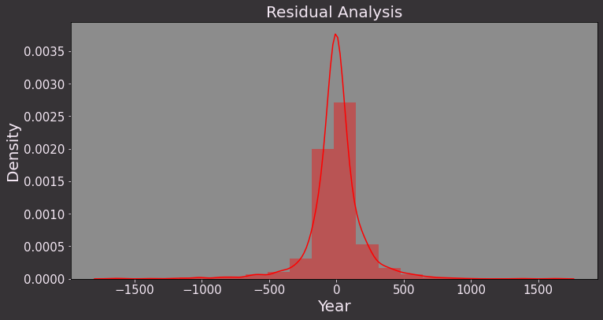
Model-1 Extra Tree Regressor
On the Test set, Extra tree considerably reduces the RMSE.
The plot below shows that, in comparison to other models, the predicted and actual values are substantially closer.
RMSE: 218.95 and an R-score of 0.878.For the Extra tree, residual values are dramatically decreased.
Most Residual values are around 0 on the KDE plot, which is significantly leaner.

Slide 21
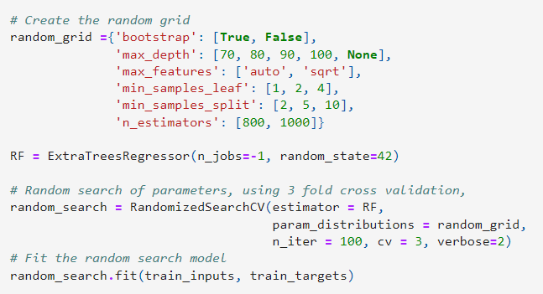

Hyperparameter Tuning of Extra Tree Regressor
We used the random search cv approach for hyperparameter tuning to identify the ideal hyperparameters for our model.
Only R-Score.885 and RMSE: 212.78 increased after hyperparameter tuning by 0.76%.

Slide 22
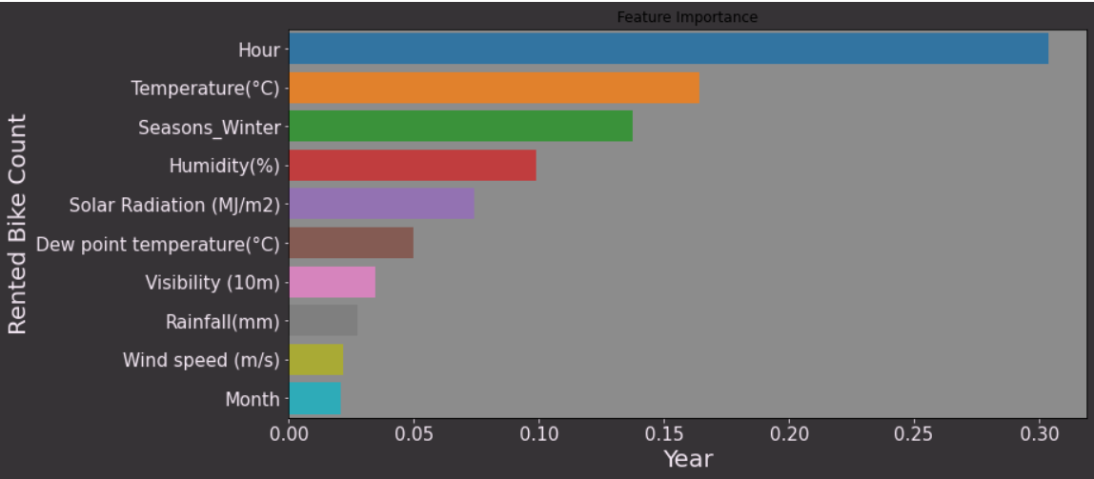
Feature Importance
The significance of the characteristics on our number of rented bikes is depicted in the accompanying graph.
One of the main elements influencing the demand for motorcycles is the temperature and time of day.
Other factors that affect demand for motorcycles include solar radiation, humidity, rainfall, and whether it is a working day.

Slide 23
Model 2 - Light GBM
A gradient boosting system called Light GBM makes use of tree-based learning techniques.
It has the following benefits and is distributed and effective by design:
1. Increased efficiency and training pace.
2. Reduced memory use.
3. More precise.
4. Assistance with distributed, parallel, and GPU learning.
5. Capable of managing massive amounts of data.
On the Test set, Light GBM greatly reduces the RMSE. The plot below shows that, in comparison to other models, the predicted and actual values are substantially closer. RMSE: 218.95 and an R-score of 0.878.

Slide 24
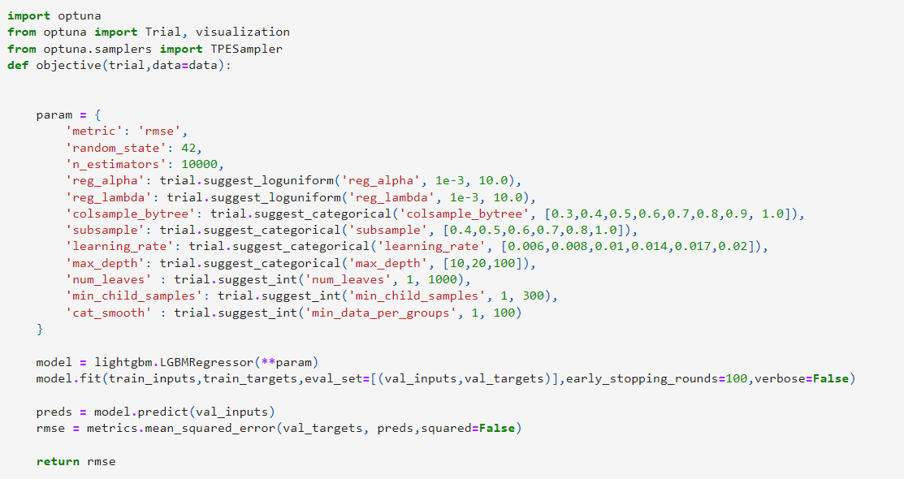
Hyperparameter Tuning of Light GBM
We used the Optuna Library for hyperparameter tuning to identify the ideal hyperparameters for our model.Optuna uses a Bayesian approach to search.

Slide 25
Conclusion
Summer was the season with the highest number of bike rentals, followed by Autumn, Spring, and Winter. The busiest months for renting bikes are May through July, and December through February are the least popular months.
The working class makes up the vast majority of customers in the bike rental industry. The EDA analysis shows that in Seoul, the demand for bikes is higher during the weekdays while people are at work.
The best conditions are found in the evenings, between 4 and 8 p.m., when the temperature is between 20 and 30 degrees and the humidity is between 40 and 60 percent.
Major elements influencing the demand for rental bikes include temperature, daytime, solar radiation, humidity, and hour of the day.
The linear model's prediction was very low since there was a very weak linear relationship between the feature and the labels. Light GBM's best predictions have a r2 score of 0.894 and an RMSE of 203.91.

Slide 26
Thank You

